Slide 1
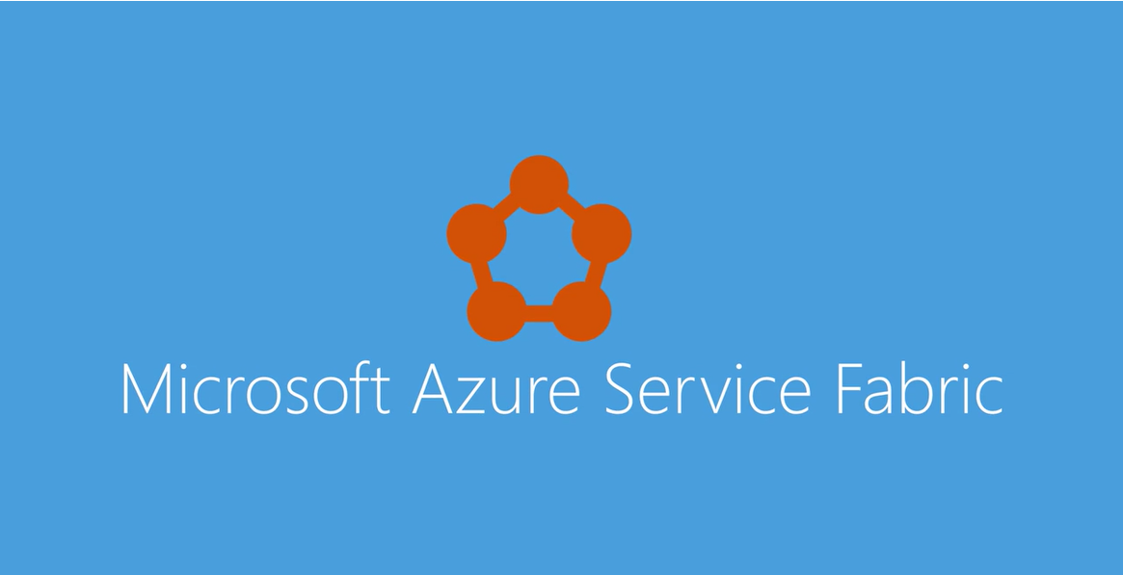

Slide 2


Slide 3
什么是Service Fabric

Slide 4
传统服务的弊端

Slide 5

All the function into one service

Slide 6

Long time deploy new feature

Slide 7


扩展很贵，慢，因为每个组件都同样的复制一份,即使是不用的部分

Slide 8

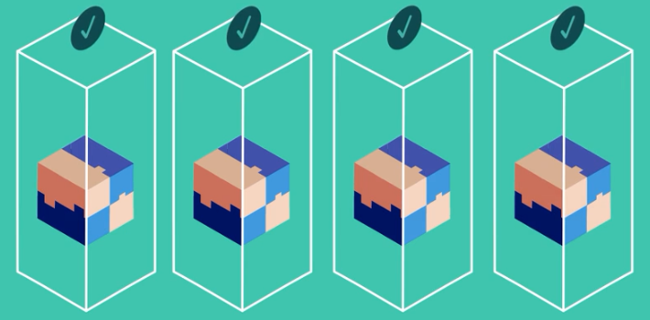
可用性和可靠性通过硬件冗余达到，more cost，complexity

Slide 9

发布时间
可用性
可扩展性

Slide 10



Slide 11


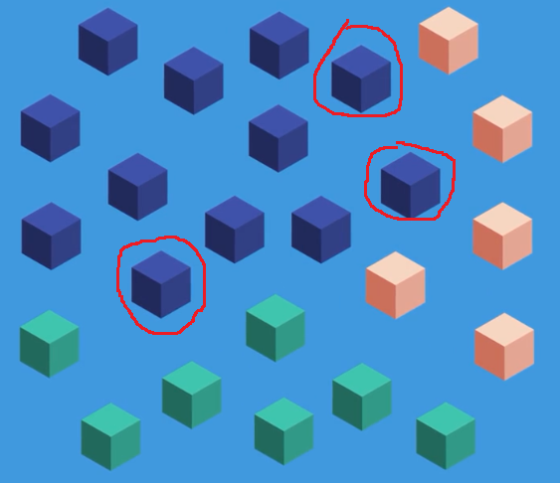
Update and scale independently, 提升质量和效率

Slide 12
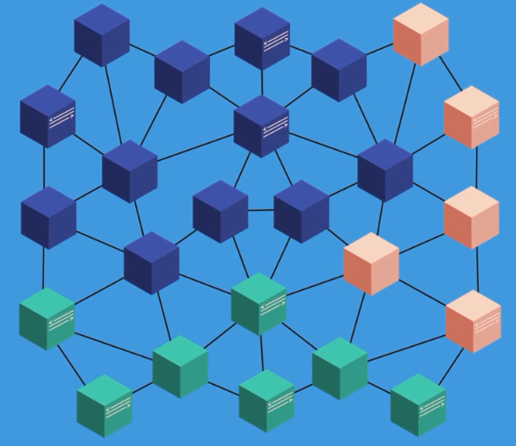
微服务 != 微信服务
Developer needs write additional code. Inter service communication and handling failures

Slide 13
Azure is an application platform that simplify building, deploying micro service base applications, to provide organization with scalable, aizhou and reliable applications. Whether they are running Azure, On-Premises, or in Other clouds, and developers get focus on code and delivery business faiyer. Which means customer get new features faster.
Azure service fabric protect applications against failures by modering cluster and automatically aiting to minegit issues.
Azure service fabric provide buting program models to simplify developing micro services.
Not only that, ilet’s you run any application code. In additional to support traditional stateless micro services, Azure service fabric support stateful micro service, core locating compute and data to reduce lll and hands performance will providing reliability through replication and persistence.
Data partitions in service will long with dynamic resource bangnecing make scaling on the demand routing.
Rolling updates

Slide 14
Service Fabric的诞生

Slide 15
Azure Service Fabric 是一款分布式系统平台，可方便用户轻松打包、部署和管理可缩放的可靠微服务和容器。 开发人员和管理员不需解决复杂的基础结构问题，只需专注于实现苛刻的任务关键型工作负荷，即那些可缩放、可靠且易于管理的工作负荷。

Slide 16
为什么要使用Service Fabric

Slide 17
Service Fabric 的优缺点

Slide 18
Service Fabric 服务

Slide 19
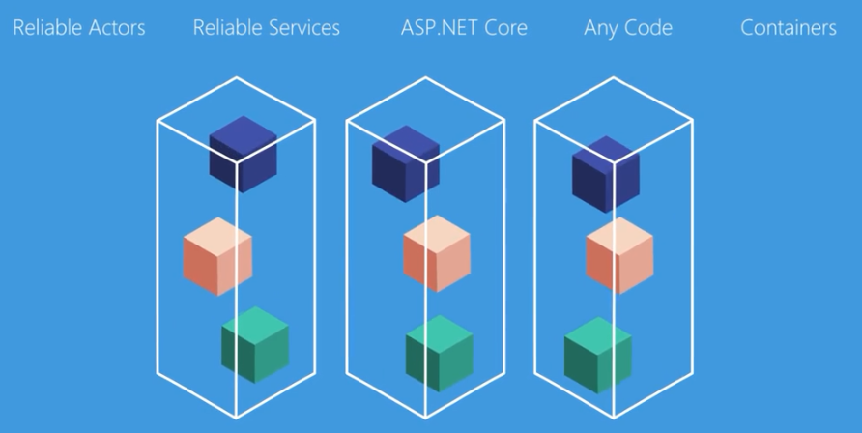

Slide 20
Service Fabric 术语

Slide 21
群集
节点
分区

Slide 22
Service Fabric 精通预告
新中国Service Fabric的领军人物 Sam Pang

